Slide 1
FRANCE - GUIDE FOR APPLICATION AND VISA
FALL 2024

Slide 2
About France
Comprises of 18 administrative regions
with Paris as the capital.
Population : 67 Million.
World's seventh largest economy.
Ranked as one of the top study and tourist destinations in the world.
French is the official and predominant spoken language.

Slide 3
About France
Euro (€) is the official currency of France.
Famous cities in France include:
Paris
Marseille
Lyon
Reims
Dijon
Toulouse

Slide 4
No IELTS/TOEFL
IELTS/TOEFL is not mandatory for admission but having the same will have a positive impact on the visa outcome.
Part time Jobs
Students can work up to 24 hours per week. Typical part time earning is €12 to €15 per hour. Minimum gross wage is €11.27 per hour.
Post Study Work Visa
Students are eligible for 2 years of post study work visa (this is applicable only for RNCP certified programs) on completion of a Master’s course.
No Post study work visa for Bachelor’s.

Slide 5
Why Study in France?
Internship opportunities in Multinational Companies
Most of the courses have inbuilt 4-6 months internships which may be paid or unpaid. Paid internships may come with a stipend of approx. Euros 500 per month.

Slide 6
Popular Courses
Tourism & Hospitality Management
International Business
Information Technology
Luxury Brand Management
Master in Management
Finance & Accounting
Marketing Management

Slide 7
Intakes & Deadlines
Two Intakes:
Summer - January/February
Winter - September/October
General Deadlines for Applications:
Summer - Up to 15th November
Winter - Up to 15th July
Some institutions accept applications beyond deadlines on a case to case basis.

Slide 8
Duration & Tuition Fees
Duration:
Bachelor’s course – 3 or 4 years.
Master’s course – 1 year or 2 years.
Tuition Fees:
Bachelor’s course – Approx. €9,000 to €12,000 per year (₹7 Lakhs to ₹10 Lakhs approx.).
Master’s course – Approx. €9,000 to €15,000 per year (₹7 Lakhs to ₹12 Lakhs approx.).

Slide 9
Represented Institutions
Queen Mary University of London Institute in Paris
Skema Business School
Rennes School of Business
NEOMA Business School
ESSCA School of Management
Burgundy School of Business
Instituto Marangoni fashion and design school
Excelia Group, La Rochelle
EM Normandie Business school,Paris
Berlin School of Business and Innovation, Paris
Institut supérieur du commerce de Paris - ISC, Paris
Esigelec Graduate School of Engineering
De Vinci Higher Education
College de Paris
IDRAC Business School, France
The American Business School
Le Cordon Bleu
Airways Aviation, France
Ecole Ducasse, Paris

Slide 10
Documents Required
Upload signed institution application form, if applicable, on the Course Finder Tool.
CV/Resume with contact details, Skype ID and email id of student
Mark Sheets and Transcripts of 10th, 12th and Graduation
Degree Certificate
Two Letters of Recommendation
Statement of Purpose
Copy of Passport first and last page
Medium of Instruction Letter (MOI)
Passport size photograph

Slide 11
Application Requirements
Please Note:
Provide updated mobile number, email id and Skype ID of the student as the same will be required for interview by institution.
Intimate the student that he/she will be interviewed by the institution representative and prepare the student to face it to reduce the chances of rejection.

Slide 12
Sample Questions for Interview
Here are some sample questions that are asked in interviews by institutions:-
1. What is your name?
2. What are you doing?
3. What is your education qualification?
4. Why do you want to go to France?
5. Where in France do you want to go?
6. Where is your institution located in France?
7. Which college are you going to study?
8. Which course are you going to study?
9. Why this school?
10. What are the subjects?
11. How will it help you in your career?

Slide 13
Sample Questions for Interview
12. How did you find the school name?/ How did you come to know about the institute?
13. What do your parents do?
14. When is your course going to commence?
15. Why France only?
16. Your course is available in India, why do you want to pursue the same at our institution?
17. What are your long term goals after completion of the course?
18. Who is sponsoring your studies?
19. What is your sponsor's income?
19. Have you applied to any other institution?
20. Are you working somewhere at present?

Slide 14
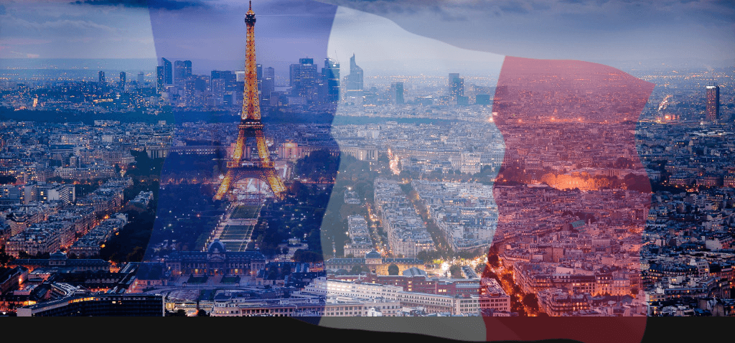
FRANCE VISA PROCESS

Slide 15
Candidates needs to face an interview for a France student VISA:
University will conduct an Interview prior to issuing the offer letter to check the English proficiency of the student.
Campus France Interview: This is an academic interview to be attended in person at the nearest Campus France. Besides copies of academic documents are attested against the original after the interview as well.
VFS France: Document submission for Student Visa.

Slide 16
FRANCE VISA PROCEDURE
STEP 1 – Register online
Register online on https://pastel.diplomatie.gouv.fr/etudesenfrance/dyn/public/login.html and complete the online “Campus France Form”. Upload all related documents and submit the form. Please email the file number (Example IN123456) that is generated on submission to the nearest Campus France office for verification of the entries and confirmation.
STEP 2 – Appointment with a Campus France Education Advisor
Request an appointment through email to the Campus France office for an academic interview with the Education Advisor for which the student will have to appear in person or Skype and furnish all mandatory documents (originals + one set of photocopies).

Slide 17
FRANCE VISA PROCEDURE
STEP 3 – Appointment at VFS France
Once the interview with Campus France is over an NOC is issued to the student after which an appointment must be booked online for the submission of documents at VFS France. For details, please visit www.vfs-france.co.in

Slide 18
FRANCE VISA PROCEDURE
Campus France Procedure
Step 1:
The student have to register online on https://pastel.diplomatie.gouv.fr/etudesenfrance/dyn/public/login.html and fill the “Campus France Form” along with uploading of documents.
The below mentioned documents (maximum size of each document should not exceed 300KB) are required in a clear, scanned and legible format for uploading.
Offer letter from French Institution
Registration certificate/Payment Receipt from French Institution
10th marksheet
12th marksheet
All the bachelor’s marksheets semester wise or annually as applicable
Provisional Degree/ Final Degree

Slide 19
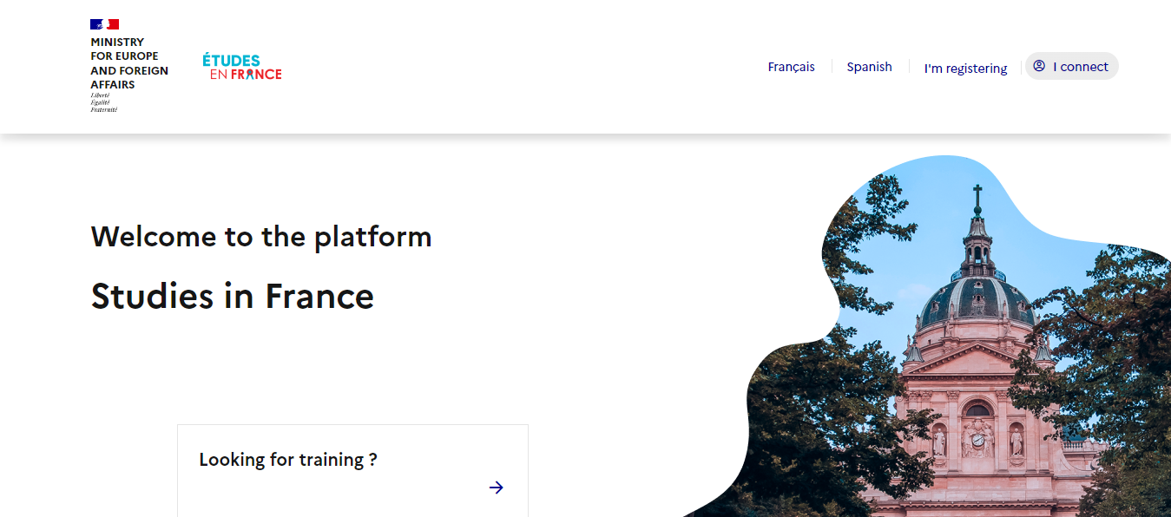
PROCESS FOR CAMPUS FRANCE APPLICATION

Slide 20
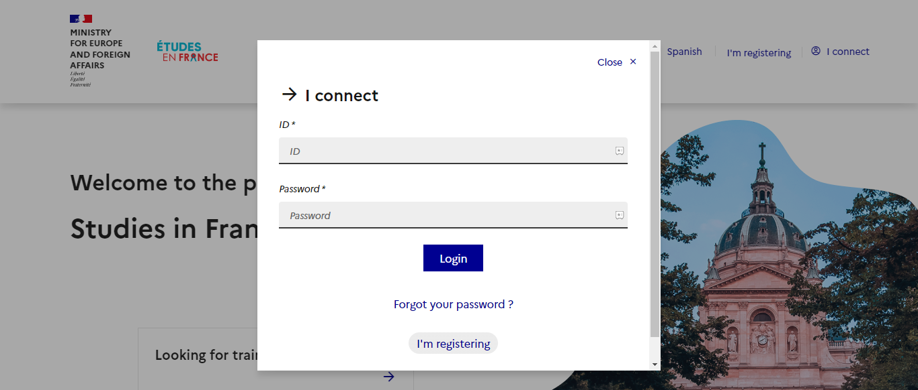

Slide 21
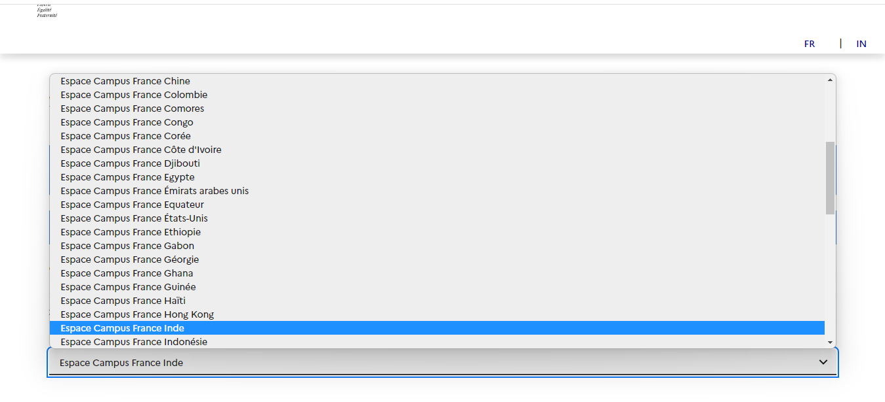

Slide 22
FRANCE VISA PROCEDURE
Step 2
Once the online form has been completed and submitted, a file number is auto generated and sent out by Campus France to the email id of the student. The student has to send an email with the file number (Example IN123456) to the nearest Campus France office for verification of the online form and scheduling of an interview.
Sample mail to be sent to the Campus France from the student’s email id: https://www.inde.campusfrance.org/campus-france-office-near-you
Subject Line: Campus France Application - (-------------) Application ID
Dear Officer,
I have submitted my online Campus France application with the ID INxx-xxxx
I request you to verify all the entries and revert with a date and time for an interview with you.
My details are as follows:
Name:
Date of Birth:
Institution going to:
Program:
Intake:

Slide 23
FRANCE VISA PROCEDURE
Step 3-
The interview schedule will be provided by the Campus France Education Advisor by email once they validate the form. The student will have to appear in person (Due to COVID-19 they are taking the interviews of the student visa on Skype) and furnish all mandatory documents as listed below (originals + one set of photocopies). The set of photocopies will be checked with the originals. A brief interview will be conducted of the student after which an NOC (No Objection Certificate) will be issued by the Advisor (Due to COVID-19, they are sending NOC via email to all students who have completed Skype interview).
Documents to be carried for the Campus France (academic interview)
Original and valid passport
All original academic documents from 10th std onwards
Work experience letters or work contracts if any
All internship certificates if any
CV
Acceptance letter from French Institution
Receipt of payment of tuition fees deposit
French Government Scholarship Attestation, if any
A printout of Campus France ID Number.
Online payment receipt of INR 17,500 /- towards Campus France processing fees
Please find link below to locate the nearest Campus France:
https://www.inde.campusfrance.org/campus-france-office-near-you

Slide 24
FRANCE VISA PROCEDURE
VFS Procedure:
Once the Campus France procedure is successfully completed and NOC is received, the student needs to do the VFS procedure.
Step 1-
Create an account on https://france-visas.gouv.fr/en_US/web/france-visas and complete the online application form.
Make sure that all steps of application are marked as confirmed. If they are, there will be a green checkmark and statement that “All the steps have been confirmed” next to your name.
Click on the “PDF” symbol to download a copy of your application. Review your entries carefully to ensure that you have provided correct information. If you need to change anything, click on the corresponding edit symbols, else print the form.
Click on “Continue” to view what supporting documentation you will need to take along to VFS.
Next please use the link to make an Online appointment at VFS:
https://france-visas.gouv.fr/web/in/a-qui-sadresser

Slide 25
FRANCE VISA PROCEDURE
Step 2-
Visa fees to be paid at VFS France.
There is a separate visa fee to be paid in cash at VFS France. VISA fees is €50. For more details, please visit www.vfs-france.co.in
Note: Cash is acceptable at VFS. The duration of the entire process varies from two weeks to a month depending on the time of the year. Visa applications filed earlier than three months before the scheduled date of departure will not be accepted.

Slide 26
DOCUMENTS REQUIRED FOR FRANCE STUDENT VISA
Print out of Long Stay application form duly filled online. Acceptance/Admission letter from a French Academic Institution.
Academic records - High School and Graduation certificate
Language Test Certifications (IELTS/TOEFL) if required by institution in France
Medium of Instruction (MOI)
Curriculum Vitae.
Experience Letter (if applicable).
Campus France NOC
Two recent passport sized photographs (ICAO Standard)
Passport, issued less than 10 years ago, containing at least two blank pages, with a period of validity at least 3 months longer

Slide 27
DOCUMENTS REQUIRED FOR FRANCE STUDENT VISA
Cover letter explaining the study project and motivation.
Funds
Proof of a minimum monthly income of €1000: Sponsorship (anyone can sponsor), Fixed Deposits, or Education Loan
(3 MONTHS OLD)
Proof of Travel Medical Insurance.
A copy of the one-way Blocked Air Ticket
Accommodation proof for at least the first 3 PO months (Booked and fully paid).

