Slide 1
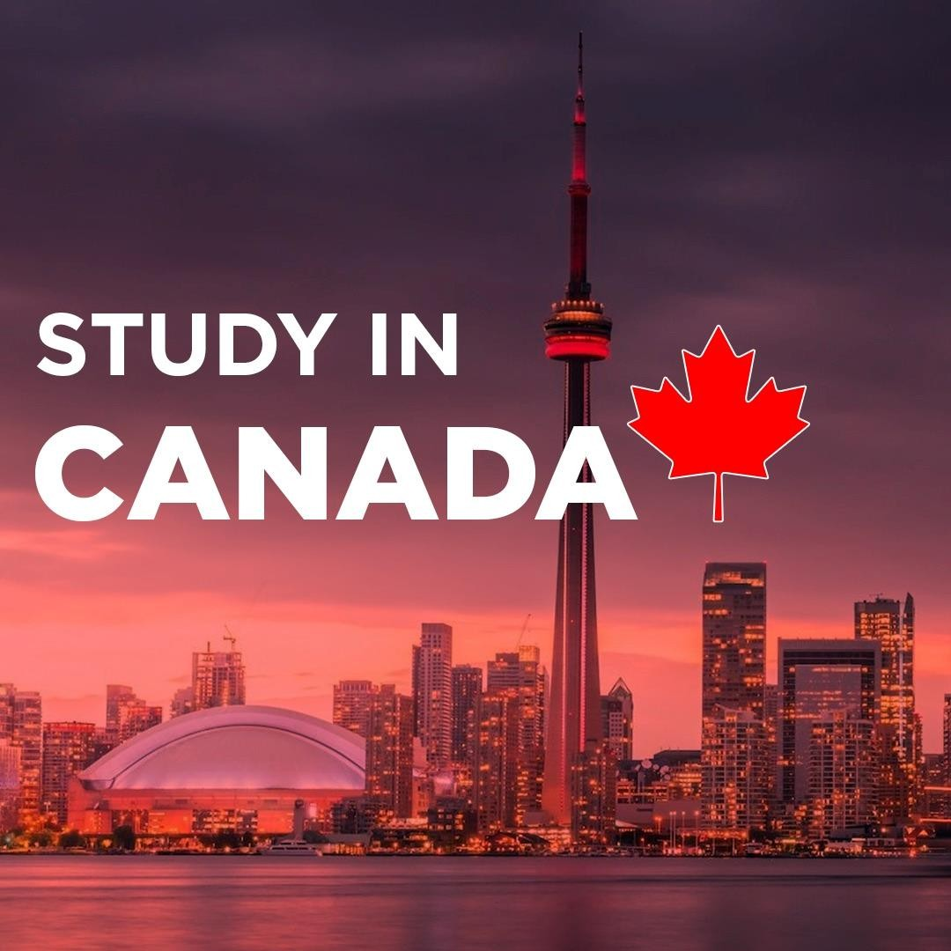

Slide 2
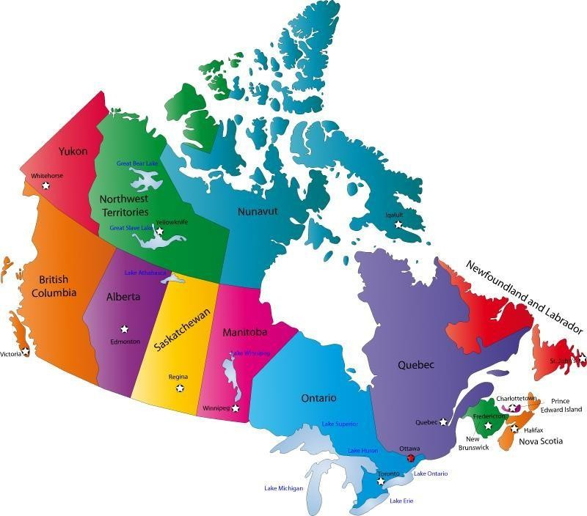
Map of Canada

Slide 3
Q: What is the capital of Canada?

Slide 4
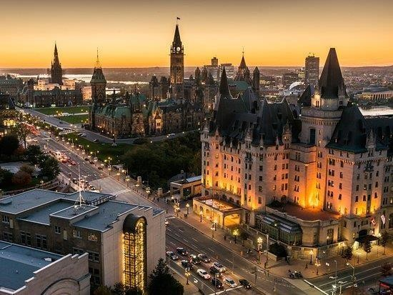
Ottawa is the capital of Canada

Slide 5
Q: How many Provinces are there in Canada?

Slide 6
There are 10 Provinces in Canada

Slide 7
Q: How many Territories are there in Canada?

Slide 8
There are 3 Territories in Canada

Slide 9
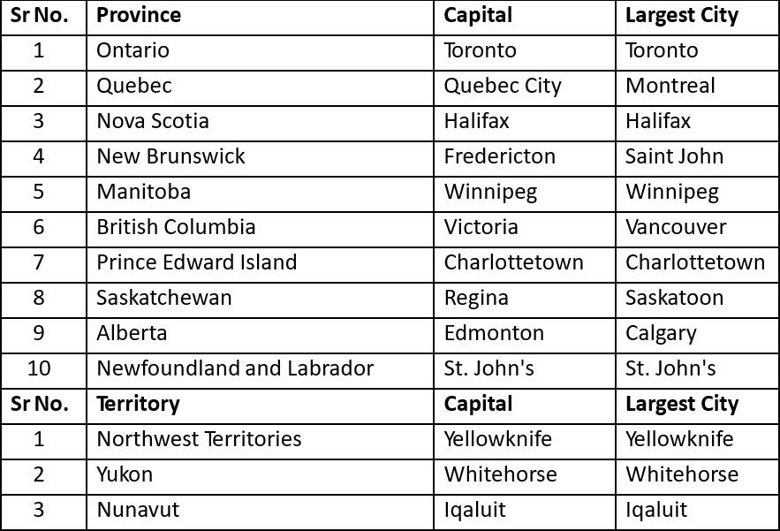
Provinces and Territories of Canada

Slide 10
Q: Which are the popular cities in Canada?

Slide 11
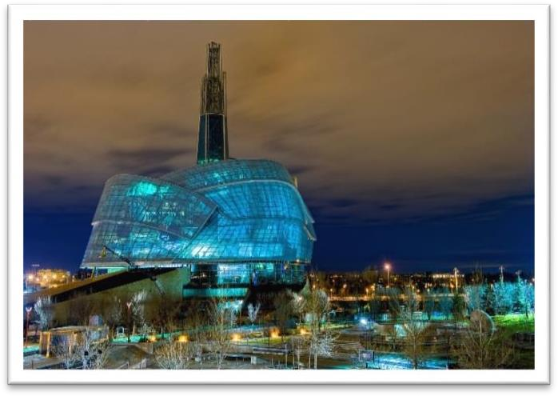
Popular Cities
Vancouver
Halifax
Toronto
Montreal
Calgary
Winnipeg

Slide 12
About Canada
Canada is the second largest country in the world.
Area of 99 lakh square kilometers with a population of around 36 million.
Culture & Society
Land of Immigrants.
Multicultural Society.
One of the most industrialized countries of the world.
Northern Canada is known for gas and oil exploration while Eastern Canada is known for agriculture, forestry and
fisheries.
The provinces of Ontario and Quebec are known for industries.
A world leader in Aerospace, Pharmaceuticals, Telecommunication and Biotechnology.
Currency is Canadian Dollar.
Almost 80% of the population of Canada lives within 250 kilometers of border
with the U.S.

Slide 13
Why Study in CANADA?
Qualifications valued around the world.
Affordable education.
Multicultural society.
Healthy and safe communities.
Possibility of paid internships while studying.
Post study work visa and good job opportunities after completion of studies.
Possibility of permanent residency.

Slide 14
Why Canada?
PNP – Provincial Nominee Program –
Provincial Nomination is an important fast-track option for Canadian Permanent Residency.
For e.g. if a student studies a course from any institution from Saskatchewan, then he can apply for PR after
completion of the course under Provincial Nominee Program if the province is participating at that point of time.
Ontario, Alberta, British Columbia, Manitoba, New Brunswick, Newfoundland and Labrador, Northwest Territories, Nova Scotia, Prince Edward Island, Saskatchewan and Yukon are the provinces which periodically participate in the Provincial Nominee Program (PNP).
Facility of Super Visa is offered to parents.
Super Visa (Super Visa) is a temporary resident permit that allows parents and grandparents of permanent residents or citizens of Canada to stay for up to 2 years in Canada per visit. It is valid for up to 10 years. A regular multiple-entry visa is also valid for up to 10 years.

Slide 15
Process Flow for Canada Study Visa
Academic IELTS
GIC
Application
Payment of GIC Amount
Application
Process
Tuition Fee Payment
Medical Examination
Offer Letter
Arranging Finances
Visa Submission

Slide 16
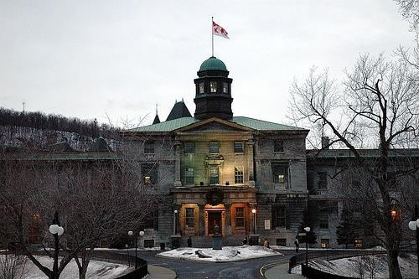
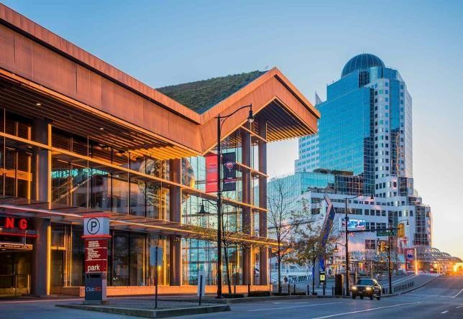
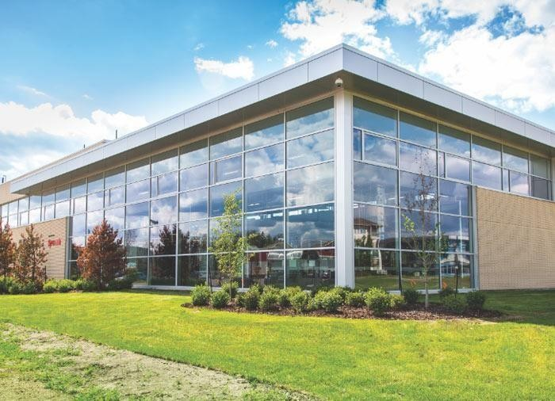
Education System in Canada
Education in Canada is generally funded and managed by the Provincial Governments of Canada
Universities
Community Colleges
Private Colleges

Slide 17
Q: How many Universities are there in Canada?

Slide 18
There are 98 Universities in Canada

Slide 19
Q: Which are the top ranked Universities in Canada?

Slide 20
Top Ranked Universities
Canada has 3 universities which are in the top 100 world ranking.
•
•
•
University of Toronto McGill University
University of British Columbia
Apart from the above there are 10 more Universities of Canada which appear in the top 300 universities in world
rankings.
University of Alberta McMaster University
University of Montreal University of Waterloo University of Western Ontario
•
•
•
•
University of Calgary Queens University Dalhousie University University of Ottawa
•
•
•
•
•

Slide 21
Universities
Q : What are the level of programs offeredby Universities in Canada?

Slide 22
Universities
Bachelors, Masters and PhD programs
Masters and PhD Programs are available at Universities only

Slide 23
Community Colleges
Q: How many Community colleges are there in Canada?

Slide 24
Community Colleges
There are 150 Community Colleges across Canada.

Slide 25
Programs offered by Colleges
Q: What are the level of programs offeredby Colleges in Canada?

Slide 26
Programs offered by Colleges
UG Diplomas, University Transfer programs, Bachelor Degrees and PG Diplomas

Slide 27
Duration of Qualifications
Q: What are the durations of the Degrees and Diplomas in Canada?

Slide 28
Categorization and Duration of Qualifications
Degrees | Program Duration
Doctoral or PhD | 2 – 5 Years
Masters | 2 Years
PG Diploma / Graduate Certificate | 1 – 2 Years
Bachelors | 4 Years
UG Diploma | 2 – 3 years 2-year program is a Diploma and 3-year program is an Advanced Diploma

Slide 29
Intakes
Q: What are the intakes available in Canada?

Slide 30
Intakes
The main Intakes are September, January and May.
There are limited intakes in July and October as well.

Slide 31
Academic & English Language Requirements
Programs | Entry Requirements | IELTS | TOEFL | PTE
Masters | 16 Years of full-time education 65% and above in Bachelors | 6.5 (6.0) | 88 | 62
PG Diplomas | 15 Years of full-time education 50-55% and above in Bachelors | 6.5 (6.0) | 88 | 62
Bachelors | 12 Years of full-time education 60% and above in grade 12 | 6.5 (6.0) | 79 | 62
UG Diplomas | 12 Years of full-time education 50-55% and above in grade 12 | 6.0 (6.0) | 79 | 58

Slide 32
Designated Learning Institutions
To apply for a study permit on or after 1st June 2014, an international student will need to have a letter
of acceptance from a designated learning institution.
Each province and territory in Canada is responsible for designating educational institutions at the post- secondary level that may enroll international students on or after 1st June 2014.
This list of designated learning institutions can be found on the below mentioned link.
http://www.cic.gc.ca/english/study/study-institutions-list.asp
If a study permit application is made on or after 1st June 2014 and the letter of acceptance is from an
institution that is not designated for international students, the visa application will be refused.

Slide 33
Work Permit for Students
Q: What is the criteria for International Students to work while studying in Canada?

Slide 34
Work Permit for Students
Students are eligible to work part time on or off campus from day one.
Study permits will automatically authorize the holder to work on/off-campus for more than 20 hours per week during the academic session and full-time (i.e. 40 hours per week) during scheduled breaks without the need to apply for a separate work permit. The study permit holder should be pursuing an academic, vocational or professional training of six months or more that leads to a degree, diploma or certificate at a Designated Learning Institution.
Since November 2022 Canadian government has a;lowed students to work for unlimted hours except for their classes.
Co-op & Internship Programmes : Many of the programs have inbuilt internships of one or two semesters which provide an opportunity for the student to get first hand exposure and experience in Industry relating to his or her area of study.
Co-ops are for a semester or more and are mostly paid.
Internships are for lesser time period i.e. 15 days to 30 days and may or may not be paid.

Slide 35
Post Study Work Visa
Q: What is Post Study Work Visa?

Slide 36
Post Study Work Visa
All international students who have graduated from a Canadian post-secondary institution are eligible for a Post Study Work Visa to gain valuable Canadian work experience.
To be eligible for a Post Study Work Visa, international students
Should have studied full-time for at least eight months preceding the completion of their program and have graduated from a Designated Learning Institution.
Must have completed and passed the program of study and received written notification that they are eligible to obtain their degree, diploma, or certificate.
Must apply for a post study work permit within 180 days of receiving written confirmation by way of final marksheets from their academic institution.
The Post Study Work Visa provides no restrictions on the type of employment and requirement of a job offer.

Slide 37
Post Study Work Visa
lf the program duration is less than 8 months - Students are not eligible for a Post
Study Work Visa.
If the program duration is more than 8 months but less than 2 years -
Post Study Work Visa will be issued for the same length as the study program.
completed a 9-month program, a work permit may be issued for up to 9 months).
(For example, if student
If the program duration is 2 years or more - Post Study Work Visa will be issued for 3 years.
If a student has completed more than one program, they may be able to get a PSW that combines the length of
both the programs. For this, each of the programs they have completed must be -
Post Study Work Visa eligible and at least 8 months in length

Slide 38
SDS – Student Direct Stream

Slide 39
SDS – Student Direct Stream
The Immigration, Refugees and Citizenship Canada launched the Student Direct Stream (SDS) program to streamline the visa process for Indian students aspiring to study at Universities and Colleges in Canada.
SDS Program Requirements:
Students applying for a program under SDS must meet the following eligibility criteria:
Admission to a full-time program at a University, College, Institute or CEGEP which is a Designated Learning Institution.
An Academic IELTS (Overall 6.0) OR TOEFL (Overall 83) OR PTE ( Overall 60) taken within past two years.
Purchase of a special Guaranteed Investment Certificate (GIC) of CAD$ 10,000 to cover living expenses for the first year of
stay in Canada.
Proof of payment of the tuition fee for one (1) year.
Upfront medical examination at least one week before submission of the visa application.
All visa applications must be filed online electronically.

Slide 40
SDS- Student Direct Stream
Advantages of applying under SDS:
Streamlined visa process.
Minimal financial documentation.

Slide 41
Q: What are the expenses for one year to study in Canada?

Slide 42
Total Cost for 1 year Diploma Program
Estimated cost to be incurred by a student for a year of study in Canada |  | CAD $1 = Rs.60/-
Sr. No. | Particulars | Amount in CAD $ | Amount in Rs.
1 | IELTS Exam Fee |  | 16,250
2 | Tuition Fees for one-year (Actual tuition fees may vary from Institution to Institution) | 15,000 | 9,00,000
3 | Living and Accommodation | 10,200 | 6,12,000
4 | Airfare from India to Canada |  | 55,000
5 | Visa Fees (Including Biometric Fees) | 235 | 14,100
6 | Total Expenses |  | 15,97,350
7 | Less Earning through Part Time Jobs | 11,500 | 6,90,000
8 | Total Expenses for Study in Canada |  | 9,07,350
 | Total Expenses Rounded Off |  | 9,00,000

Slide 43
Total Cost for 1 year Degree Program
Estimated cost to be incurred by a student for a year of study in Canada |  | CAD $1 = Rs.60/-
Sr. No. | Particulars | Amount in CAD $ | Amount in Rs.
1 | IELTS Exam Fee |  | 16,250
2 | Tuition Fees for one-year (Actual tuition fees may vary from Institution to Institution) | 20,000 | 12,00,000
3 | Living and Accommodation | 10,200 | 6,12,000
4 | Airfare from India to Canada |  | 55,000
5 | Visa Fees (Including Biometric Fees) | 235 | 14,100
6 | Total Expenses |  | 18,97,350
7 | Less Earning through Part Time Jobs | 11,500 | 6,90,000
8 | Total Expenses for Study in Canada |  | 12,07,350
 | Total Expenses Rounded Off |  | 12,00,000

Slide 44
Institutions partnered with Academic Monk
The updated list of institutions are mentioned below

Slide 45
PG Programs with IELTS 6 no band less than 6 bands
Sr. No. | Name of the College/University | Programs being Offered
1 | University Canada West, Vancouver, British Columbia | MBA (With ESL of 3 months)
2 | North Island College, Vancouver Island, British Columbia | All PG programs
3 | College of New Caledonia, Prince George, British Columbia | All PG Programs
4 | Coast Mountain College, Terrace, British Columbia | All PG Programs
*Meeting the minimum application requirement does not guarantee an admission

Slide 46
PG programs with IELTS 6 no band less than 6 bands
Sr. No. | Name of the College/University | Programs being Offered
5 | Bow Valley College, Calgary, Alberta | All PG Programs
6 | Southern Alberta Institute of Technology, Calgary, Alberta | All PG Programs
7 | Northern College, Timmins, Ontario | Supply Chain Management, Information Systems Business Analysis, Global Business, Entrepreneurship & Technology, Cybersecurity
8 | Manitoba Institute of Trades and Technology, Winnipeg, Manitoba | Post Grad Cert in International Business Post Grad Cert in Leadership and Management
*Meeting the minimum application requirement does not guarantee an admission

Slide 47
Our represented Institutions offering an Application Fee Waiver
Adler University
Fanshawe College
Fanshawe College @ ILAC Toronto
Portage College @ CIOT Campus, Calgary, Alberta
King’s College (University of Western Ontario)
Lambton College
Fraser International College (Only UG)
International College of Manitoba (Only UG)
Wilfrid Laurier International College (Only UG)
Toronto Metropolitan International College (Only UG)
Acsenda School of Management

Slide 48
Scholarships
Scholarships in Canada are quite competitive as they are very limited in number as scholarships offered by other countries like USA, UK or Australia.
compared to
The eligibility for scholarships is judged on the basis of outstanding academic grades and
exceptional English Proficiency scores.
Scholarships are mostly offered by the universities without any separate application, based on the eligibility benchmarks but at some institutions the students need to apply specifically for the same.
Scholarships are majorly offered at the entry level but for some scholarships the students are
supposed to prove their excellence in academics in the subsequent years of education as well.

Slide 49
Points to remember for successful Offers and Visas
Do not apply for students who do not meet the IELTS criteria. Minimum 6.0 with no band less than 6.0 for UG and overall 6.5 with no band less than 6.0 for PG.
Do not apply for students who have several failed courses, large gaps of 5 or more years in studies (regardless of their work experience) and inconsistency in program choice with past studies. Course choice must be relevant.
Good academics of the students: We have seen higher rate of visa approvals for students having 60% and
above throughout their academic qualifications.
Also we have noticed that if a student has low academics as well as a gap of 2-5 years after completion of last studies, the case is weak, and visa may be refused

Slide 50
Do Universities or Colleges in Canada assist in Job Placements?
Most Institutions have :
A Training and Placement Centre which helps the students in preparing their CV an for Interviews according to Canadian requirements.
Many institutions conduct Job Fairs in which various local companies participate.
It is quite likely that the students enrolled in a co-op program will get placed in their respective companies where they have done their co-op.

Slide 51
Sources of Finance
Q: What can be the sources of Funds to study in Canada?

Slide 52
Sources of Finance
Self funded / Parents / Grand Parents.
Fixed Deposits / Government Provident Fund / Public Provident Fund / Funds in Savings Account.
Loans from approved banks. Repayment commences upto one year after graduation or 6 months after securing a job whichever is earlier. The period for repayment also varies and may be upto 15 years

Slide 53
Submitting a Winning Application
Completed Application Form
Academic Records
Standardized Examination Scores
Work Experience details if any
Application Fees if applicable
SOP and Recommendation Letters required for universities only.

Slide 54
Counseling Tips
Identify the suitability of the profile for Canada.
Do not accept students below 50% for Colleges and below 65% for Masters in the University.
Do not accept students with long gaps and multiple backlogs.
Check English Language ability.
Tell students about Co-op work opportunities.
Inform the student about the benefits of studying in Canada as compared to other countries.
Most Important – Talk about PR Opportunity, Part time work, full time job opportunities.
Talk about the lesser investment and higher gains.

